Slide 1
CWRU Data Analytics Boot Camp Spring 2020 Project Two Impact of Covid-19 on America- A look into the Stock Market, Weather, Rate of Infection as a relation to the Population Density Github Repository - https://github.com/coconutpep/US-COVID19-Effect
Goutham Polavaram, Ibrahim Oumar, Ryan Kleug, Sumeet Dhawan

Slide 2

Background & Objective
United States has been effected by Novel Cornonavirus-Covid19 Pandemic
Power of Data Analysis , Visualization, Predictions, and Modeling have come to the forefront as different agencies have relied on it to make strategic decisions ( JHU and UW models are now globally used)
Major Objective is to investigate how stocks, hospitals and weather statistics changed during the Coronavirus Pandemic in comparison with the spread of infection across the continental US in the time period of January-April 2020

Slide 3





Data Sources
Infection Rate & Hospital Bed Related Data
Stock Market: Yahoo Finance API for Python
Weather Related Data - EPA Air Quality System (AQS) APY
US Census Data

Slide 4

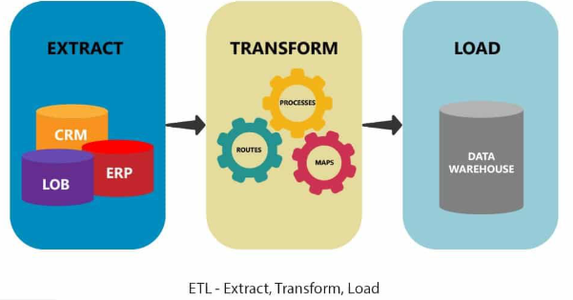



Methodology
ETL Process on the Data Source
D3 data ingests via API call and JSON
Developed an Interactive Dashboard to visualize multiple charts
Additional JS Library Used – Billboard.js (To visualize stock data)
Heroku and AWS used for database storage
Heroku utilized for Deployment

Slide 5
Visualizations 🡪Demo
https://covid19bootcampproject3.herokuapp.com/

Slide 6
Key Takeaways
Infection Rate in US related to Population Density was visualized
Weather Data: Explored how four major air quality parameters have changed through heatmaps over the course of the COVID-19 pandemic in America
Stock Data has been very volatile during the last three months with a deep fall and is now making big gains across many Tech and E-Commerce related companies, and even airline

